Slide 1
Bitcoin – anonymity [mixes + Coinjoin + high-level flows]

Slide 2
Online wallets
no guarantee of mixing
internal records
security and legal compliance
identity record
just like traditional banks!
extra risk!
1
Notes:
-even if they mix your funds, they keep internal records
-reputable wallets even have customer identity on record
-better than no privacy!
-from point of view of a stranger, we have *some* privacy
-but blockchain is public – so if something goes wrong (e.g. internal records get hacked), privacy risks may be worse than traditional banking system

Slide 3
Dedicated mixes
do not keep records
do not ask for identity
accountability issues
terminology: mix and mixer vs. laundry
2
Notes:
-the mix may take all your money and run

Slide 4

Best practices for mixes
use a series of mixes!
Tor – three routers
Mix 1
Mix 2
Mix 3
3
Notes:
-if even a single mix is honest, no one can link your inputs and outputs

Slide 5
Best practices for mixes
use uniform transactions
‘chunk’ size
all mix transactions must have the same value
standardization issues
large chunks
small chunks
multiple sizes?
4
Notes:
-large chunks – not good for small size inputs
-small chunks – inefficient for large size inputs
-multiple chunks – improve performance but anonymity size would split

Slide 6
Best practices for mixes
side-channel attacks
client side should be automated
privacy-friendly techniques
mixing fees
solution? fees should be all-or-nothing
probabilistic application
0.1% fees, 1000 tries, swallow one input
trust issues
5
Notes:
-clever adversary may deanonymize transaction by side-channel attacks, observing timing of transactions, etc.
-if inputs are not precisely standardized, fees can be complicated and problematic for anonymity
-how do you know mix is acting honestly?

Slide 7
Mixes in practice
Caution: Mixing services may themselves be operating with anonymity. As such, if the mixing output fails to be delivered or access to funds is denied there is no recourse. Use at your own discretion.
— Bitcoin Wiki
6
Notes:
-reputation issues
-power law effect
-https://bitcoinmix.org/

Slide 8
Decentralized mixing
bootstrapping problem
theft is impossible
coordination
easier
potentially improved anonymity
more philosophically aligned with Bitcoin
7

Slide 9


coinjoin
Single
transaction
Gregory Maxwell
mixing rounds
8

Slide 10
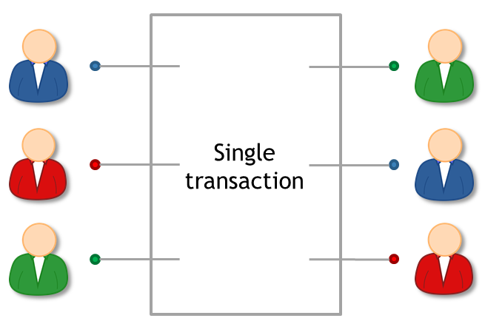
Coinjoin: algo
find peers who want to mix
exchange input/output addresses
construct transaction
send it around, collect signatures
broadcast transaction
9

Slide 11
Coinjoin: issues
finding peers?
peers know your outputs
denial of service
10
Notes:
-meeting peers who want to mix? Watering holes?
-peers can see your outputs (worse than centralized mix problem) – why?
-use anonymous routing mechanism
-example: submit inputs, disconnect and reconnect over Tor, then submit outputs
-denial of service: malicious peer could execute in first round of protocol and then refuse to sign
-or malicious peer could double-spend her own input, thereby invalidating the whole Coinjoin transaction

Slide 12
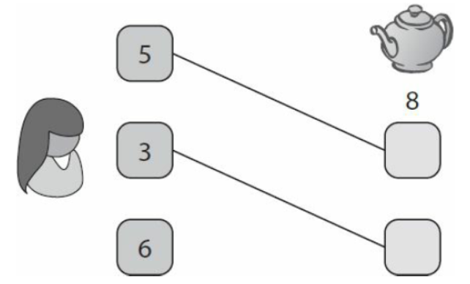
High level flows
e.g. Alice receives 43.12312 BTC / week as income
always immediately transfers 5% to retirement account
heuristic: merge avoidance
instead of single payment transaction, receiver provides multiple output addresses
sender avoids combining different inputs
11
Notes:
-also defeats clustering

Slide 13
Homework
Chap 6: Bitcoin and Anonymity Bitcoin and Cryptocurrency Technologies: A Comprehensive Introduction
12

Slide 14
Further reading
A big mixnet closes (link)
13

